Slide 1

Data Mining

Slide 2
What is Data Mining ?
Data mining is the process of finding patterns in a given data set. These patterns can often provide meaningful and insightful data to whoever is interested in that data. Data mining is used today in a wide variety of contexts – in fraud detection, as an aid in marketing campaigns, and even supermarkets use it to study their consumers.

Slide 3
DESCRIPTIVE FUNCTIONS
The descriptive function deals with the general properties of data in the database. Here is the list of descriptive functions −
Class/Concept Description
Mining of Frequent Patterns
Mining of Associations
Mining of Correlations
Mining of Clusters

Slide 4
CLASS/CONCEPT DESCRIPTION
Class/Concept refers to the data to be associated with the classes or concepts. For example, in a company, the classes of items for sales include computer and printers, and concepts of customers include big spenders and budget spenders. Such descriptions of a class or a concept are called class/concept descriptions. These descriptions can be derived by the following two ways −
Data Characterization − This refers to summarizing data of class under study. This class under study is called as Target Class.
Data Discrimination − It refers to the mapping or classification of a class with some predefined group or class.

Slide 5
MINING OF FREQUENT PATTERNS
Frequent patterns are those patterns that occur frequently in transactional data. Here is the list of kind of frequent patterns −
Frequent Item Set − It refers to a set of items that frequently appear together, for example, milk and bread.
Frequent Subsequence − A sequence of patterns that occur frequently such as purchasing a camera is followed by memory card.
Frequent Sub Structure − Substructure refers to different structural forms, such as graphs, trees, or lattices, which may be combined with item−sets or subsequences.

Slide 6
MINING OF ASSOCIATIONS
Associations are used in retail sales to identify patterns that are frequently purchased together. This process refers to the process of uncovering the relationship among data and determining association rules.
For example, a retailer generates an association rule that shows that 70% of time milk is sold with bread and only 30% of times biscuits are sold with bread.

Slide 7
MINING OF CORRELATIONS
It is a kind of additional analysis performed to uncover interesting statistical correlations between associated-attribute−value pairs or between two item sets to analyze that if they have positive, negative or no effect on each other.

Slide 8
MINING OF CLUSTERS
Cluster refers to a group of similar kind of objects. Cluster analysis refers to forming group of objects that are very similar to each other but are highly different from the objects in other clusters.

Slide 9
MINING ISSUES
Data mining is not an easy task, as the algorithms used can get very complex and data is not always available at one place. It needs to be integrated from various heterogeneous data sources. These factors also create some issues. Here in this tutorial, we will discuss the major issues regarding −
Mining Methodology and User Interaction
Performance Issues
Diverse Data Types Issues

Slide 10
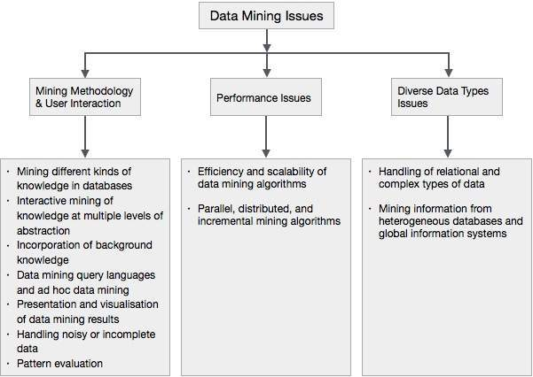

Slide 11
Applications
Banking:
loan/credit card approval.
predict good customers based on old customers.
Customer relationship management:
identify those who are likely to leave for a competitor.
Targeted marketing:
identify likely responders to promotions.
Fraud detection:
telecommunications, financial transactions from an online stream of event identify fraudulent events.
Manufacturing and production:
automatically adjust knobs when process parameter changes.

Slide 12
Example of Data Mining
If you’ve ever used a credit card, then you may know that credit card companies will alert you when they think that your credit card is being fraudulently used by someone other than you. This is a perfect example of data mining – credit card companies have a history of your purchases from the past and know geographically where those purchases have been made. If all of a sudden some purchases are made in a city far from where you live, the credit card companies are put on alert to a possible fraud since their data mining shows that you don’t normally make purchases in that city. Then, the credit card company can disable your card for that transaction or just put a flag on your card for suspicious activity.

Slide 13
Thank You
By: akanksha Pradhan 115a1078
sidharth chandran 115a1079
r s kamleshwar 115a1080

